Slide 1
Bttrpie
By: Alexander, Amit, Lawrence, Leo

Slide 2
BTTR Agenda
Design & Criteria
BTTR Procedure
Testing Procedure
Schedule
Feedback

Slide 3
Design & Criteria

Slide 4
Design & Criteria
1 motor for claw
3 motor for gantry movement
X axis
Y axis
Z axis

Slide 5
Design & Criteria
Optical sensor for detecting different balls
Bumper sensor for precise z axis motion
TouchLED sensor to initiate the reset procedure
Controller for testing and manual control
Motor encoder for position tracking

Slide 6
Big problem (pls help)
The vex motor encoders are quite inaccurate (in our experience)
Might cause severe issues with the project, as the coordinates of the gantry can only be reliably tracked via motor encoders
How do we track the motion of the gantry?

Slide 7
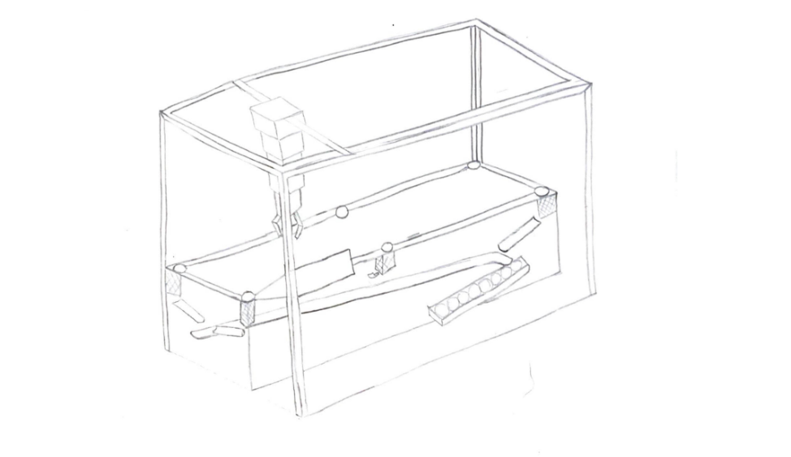
Design & Criteria
Optical sensor for detecting different balls
Bumper sensor for precise z axis motion
TouchLED sensor to initiate the reset procedure
Controller for testing and manual control
Motor encoder for position tracking

Slide 8
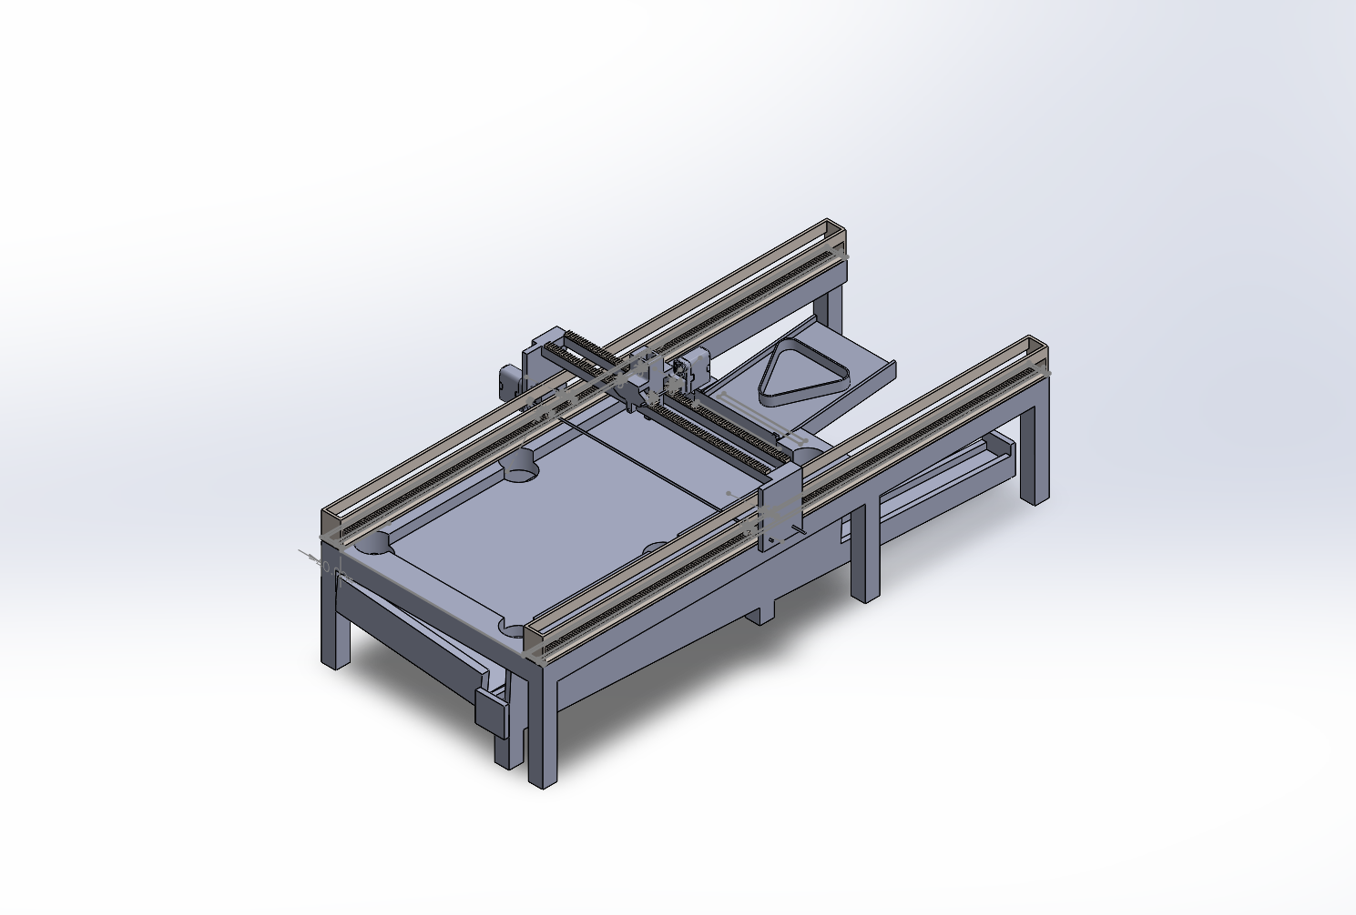

Slide 10
BTTR Procedure

Slide 11
BTTR Procedure
Sorting System
Analyze 3d printed balls that roll into a single slanted ramp
detect and identify each ball by color.
A grabber claw will then sort the balls into ordered positions.
Placing System
pick up balls in the correct order and place them into the triangular rack
Move triangle past opened section of the wall, and into proper location
lift the triangle and reset the machine to become ready for play.

Slide 12
BTTR Procedure
Sorting System
Shows optical sensor
Shows bumper
Shows TouchLED
Shows Motor Encoders
Shows all 4 motors
Placing System
Shows everything again, and therefore an optional part of the project and will only be built if time allows

Slide 13
TESTING Procedure

Slide 14
TESTING Procedure
Step 1
Play pool
Is the game of pool playable or are the physical systems and the robotics interfering significantly with play?
Are the balls collected (unsorted) in the chute?
Are the balls escaping the chute?
Step 2
Turn on the robot
Does the code compile?
Does the robot move?
Does the robot calibrate its XYZ position correctly?
Does the gantry move accurately?
Does it remain stable?
Do the cables reach as they should?

Slide 15
TESTING Procedure
Step 3
Testing BTTR procedure (Stage 1, Stage 2)
Does the claw grab and hold the balls consistently?
Does the claw detect the balls correctly?
Does the claw drop the balls correctly?
Does the robot detect the order of the balls correctly?
Does the claw pick up the the balls in the correct order?
Does the claw place balls in the triangle correctly?
Does the claw open the wall correctly?
Does the claw move the triangle correctly?
Does the claw reset the triangle correctly?
Step 4
Turn off Robot
Does the robot position reset correctly (to aid with next bootups calibration)?
Is the final position out of the way?
Is the game sufficiently reset to project stage (based on project stage)?

Slide 16
TESTING Procedure
Step 3
Testing BTTR procedure (Stage 1, Stage 2)
Does the claw grab and hold the balls consistently?
Does the claw detect the balls correctly?
Does the claw drop the balls correctly?
Does the robot detect the order of the balls correctly?
Does the claw pick up the the balls in the correct order?
Does the claw place balls in the triangle correctly?
Does the claw open the wall correctly?
Does the claw move the triangle correctly?
Does the claw reset the triangle correctly?
Step 4
Turn off Robot
Does the robot position reset correctly (to aid with next bootups calibration)?
Is the final position out of the way?
Is the game sufficiently reset to project stage (based on project stage)?

Slide 17
Schedule

Slide 18

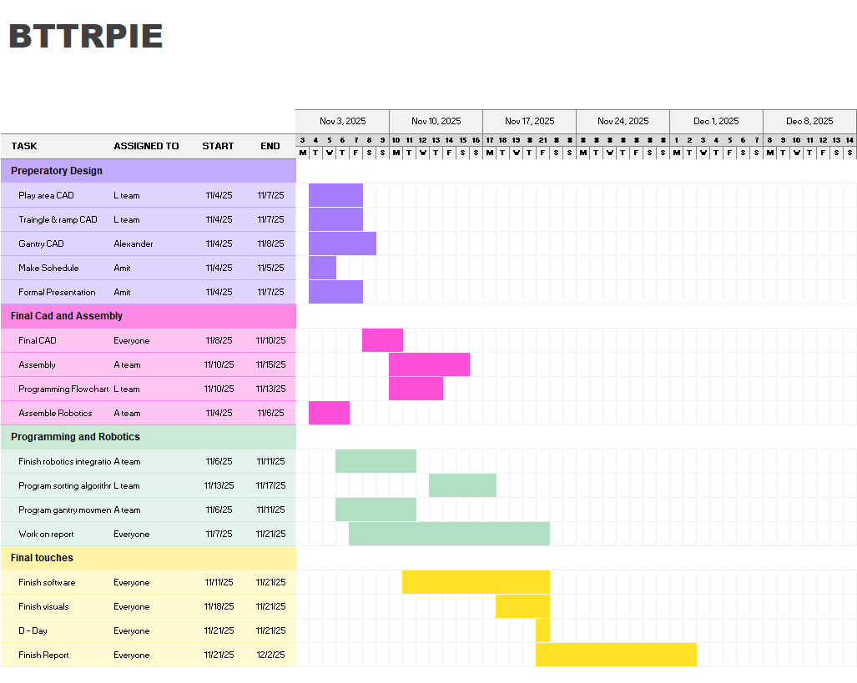

Slide 19
THANK YOU

